Slide 1
Outside the Box
Going Beyond CONTENTdm’s Website Configuration Tool
Jennifer Galas
Library Systems Specialist
Digital Services Web Developer
The University of Scranton
Weinberg Memorial Library
jennifer.galas@scranton.edu

Slide 2
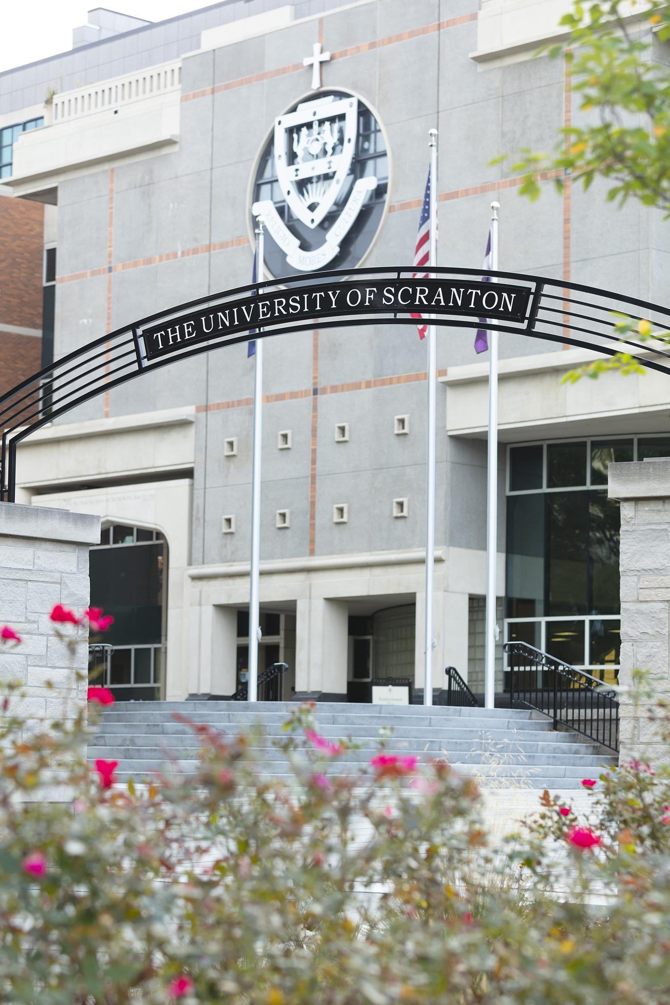
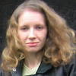
Who & Where
Jennifer Galas
Library Systems Specialist
Digital Services Web Developer
Weinberg Memorial Library at The University of Scranton
Catholic and Jesuit University
Located in Scranton, PA
80,000-square-foot, five-story building opened in 1992
Currently 77 formal collections with more to be processed!

Slide 3
Outline
Improving Organization and Visibility
Page Types
Customizations
Next Steps

Slide 4
Improving Organization and Visibility

Slide 5
Combining Collections
Web Presence Redesign
Problem
University Archives, Special Collections, and Digital Collections have similar/overlapping content, but the content is scattered across different websites and platforms.
Goal Combine University Archives, Special Collections, and Digital Collections into one website.
Desired Outcomes
Improve visibility and discovery of our rich, diverse collections, and encourage user interaction
Design a website with a consistent, attractive user interface
Create one place to store all collection information and digitized versions when available

Slide 6
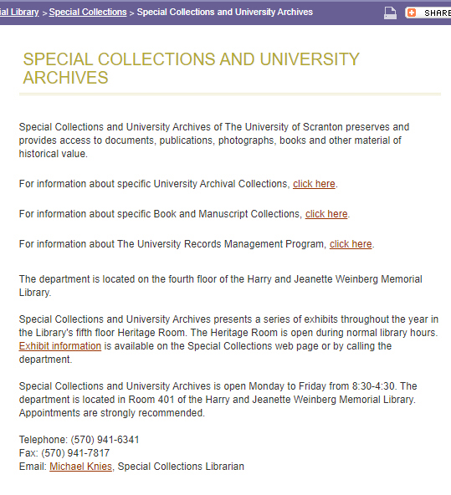
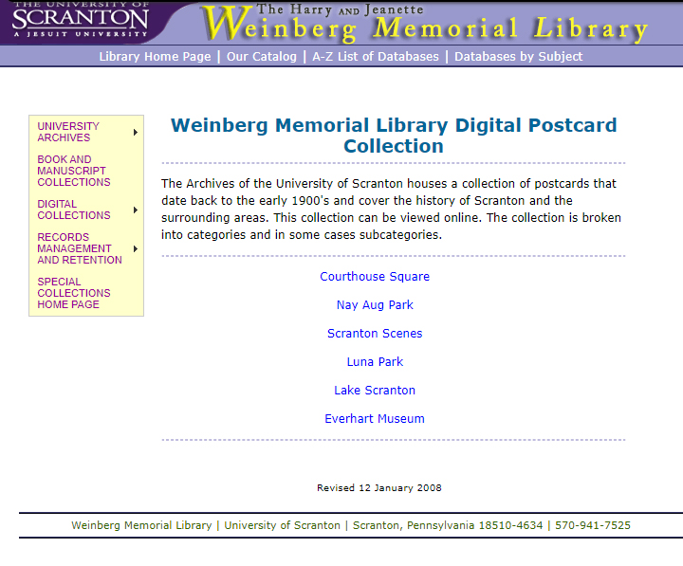
Combining Collections

Slide 7
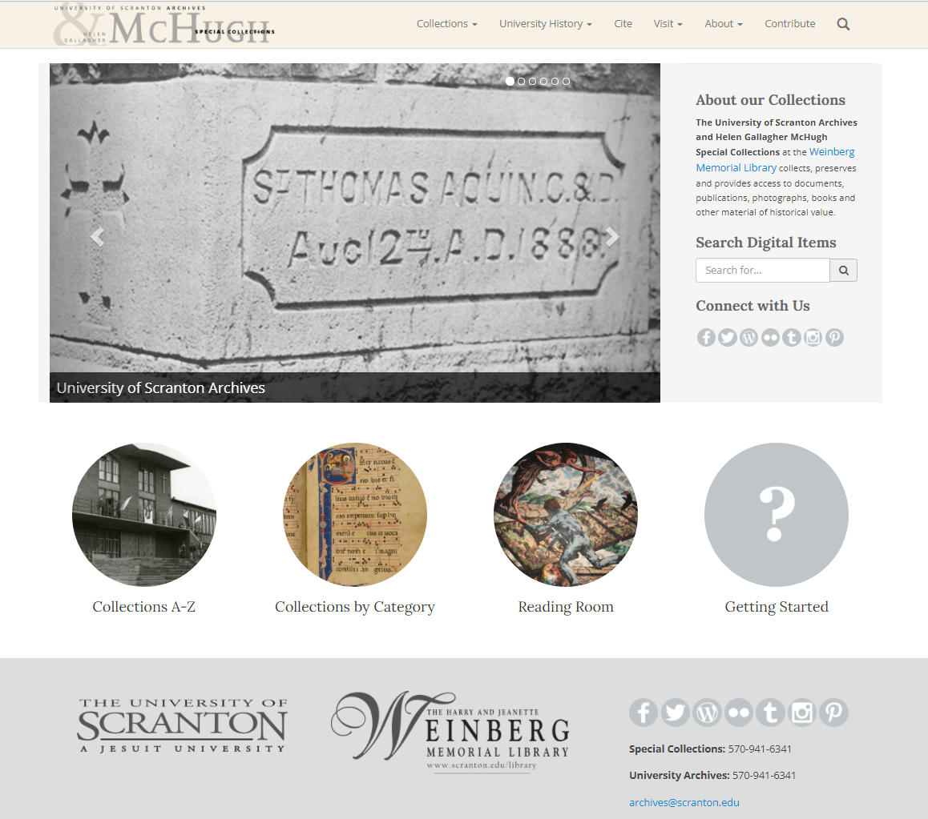
Combining Collections
Redesign completed late 2016, using CONTENTdm version 6.x.
Later redeveloped for CONTENTdm responsive.

Slide 8
CONTENTdm
Why CONTENTdm was a good choice
Many digitized items already stored in the system
Long-term, good experiences with the software and support
Ability to create custom landing pages and pages not tied to digital collections

Slide 9
Page Types

Slide 10
Page Types
Our design required different types of pages
Home page
Collection landing pages
Collection guides (similar to finding aids)
Informational pages for supporting content

Slide 11
Page Types
Home Page
Collection Specific
Additional Information
Browse Lists
About Us
Contact Us
University History
Exhibits
Citation Examples
Getting Started Guide
Collection Landing Page
Collection Guide
History/Biography
Home Page
Collection Landing Page
Custom Page

Slide 12
CONTENTdm JavaScript Lifecycle Events
Used in our global JavaScript file to target different page types and add custom functionality
cdm-home-page
cdm-collection-landing-page
cdm-custom-page
… and more!
https://help.oclc.org/Metadata_Services/CONTENTdm/Advanced_website_customization/JavaScript_customizations/List_of_JavaScript_lifecycle_events

Slide 13
Customizations

Slide 14
Global Header

Slide 15
Global Footer

Slide 16
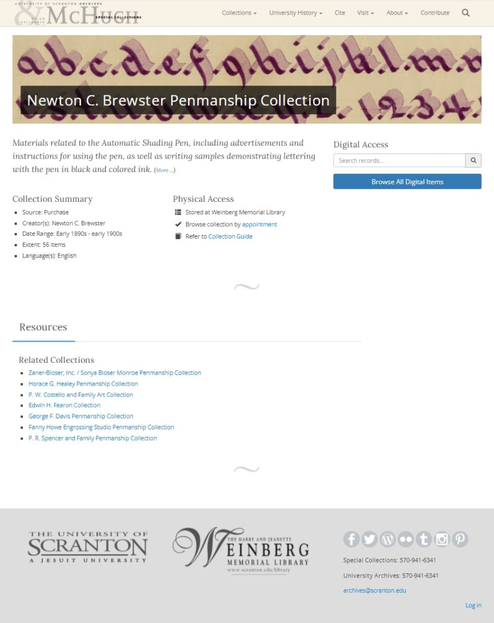
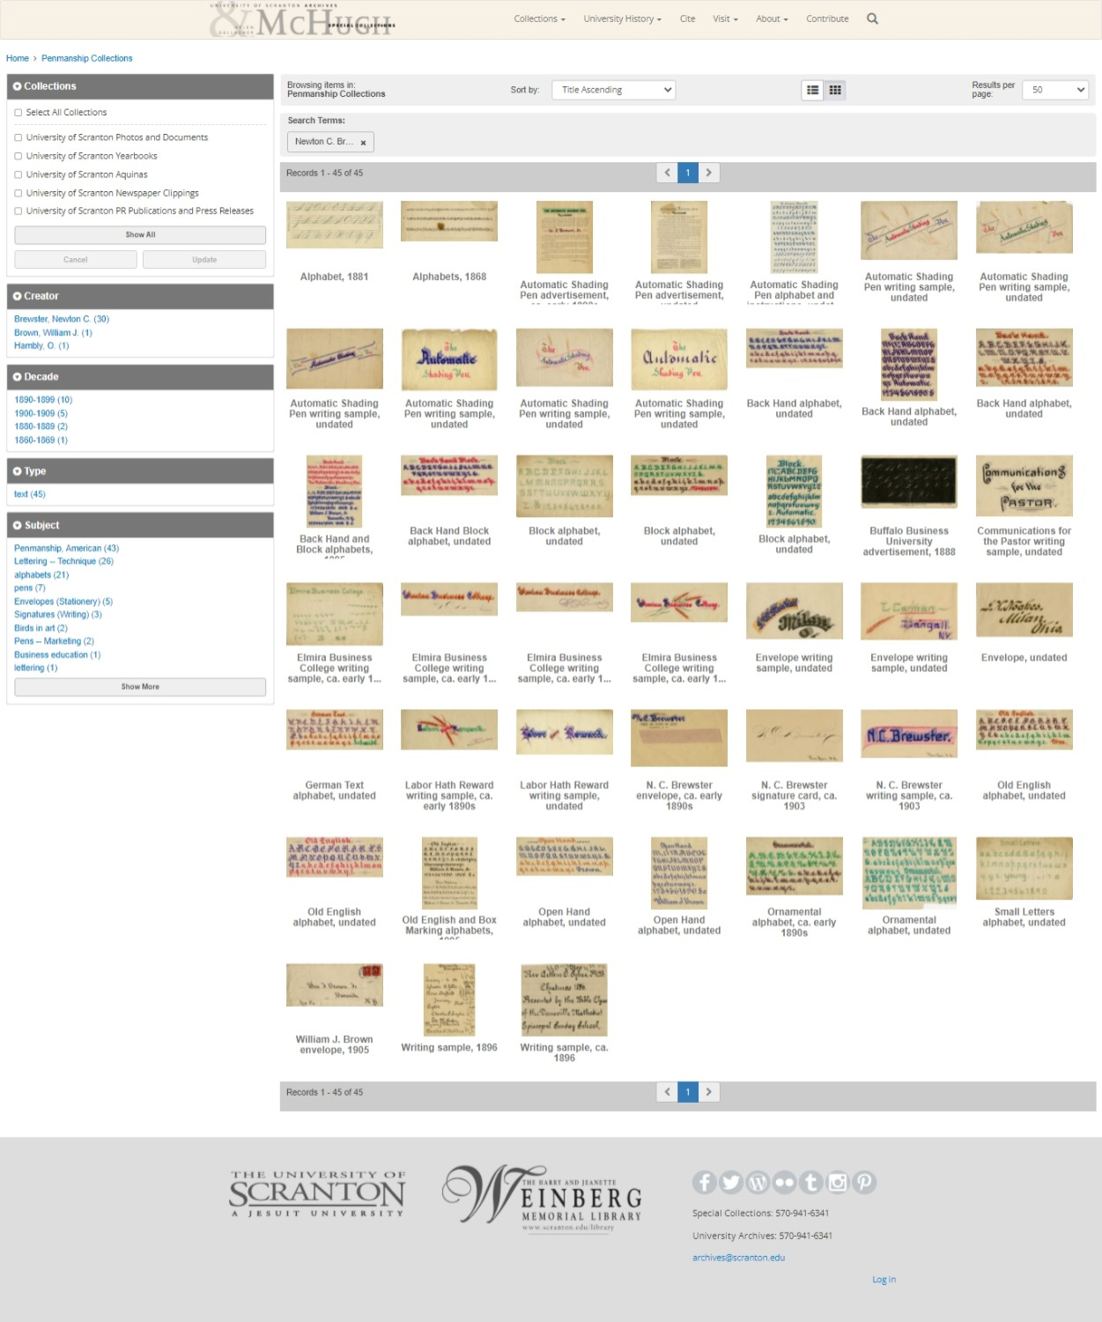
Global Header & Footer
Header and footer appear on all pages, including Results pages.

Slide 17
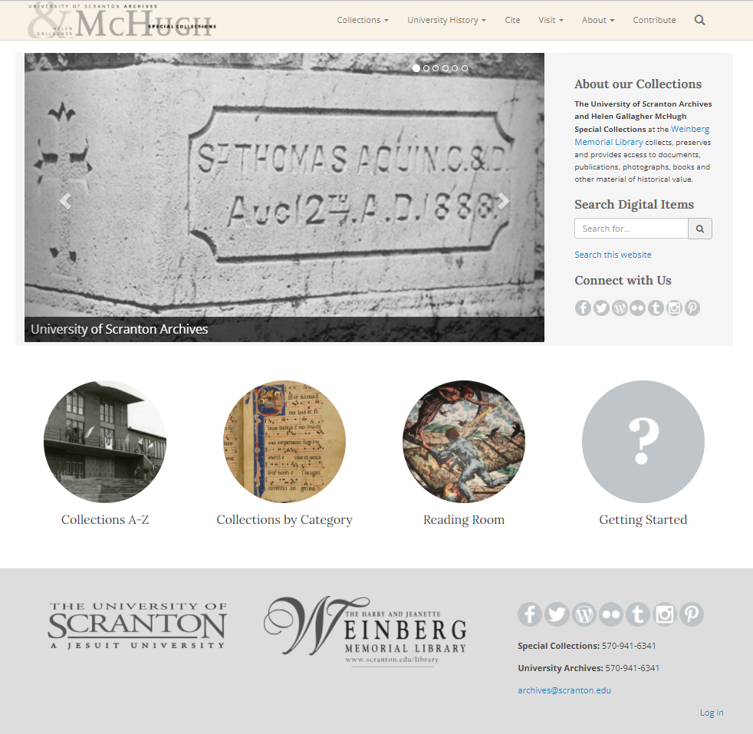
Home Page
Offers many different ways to find and view the items in our collections

Slide 18
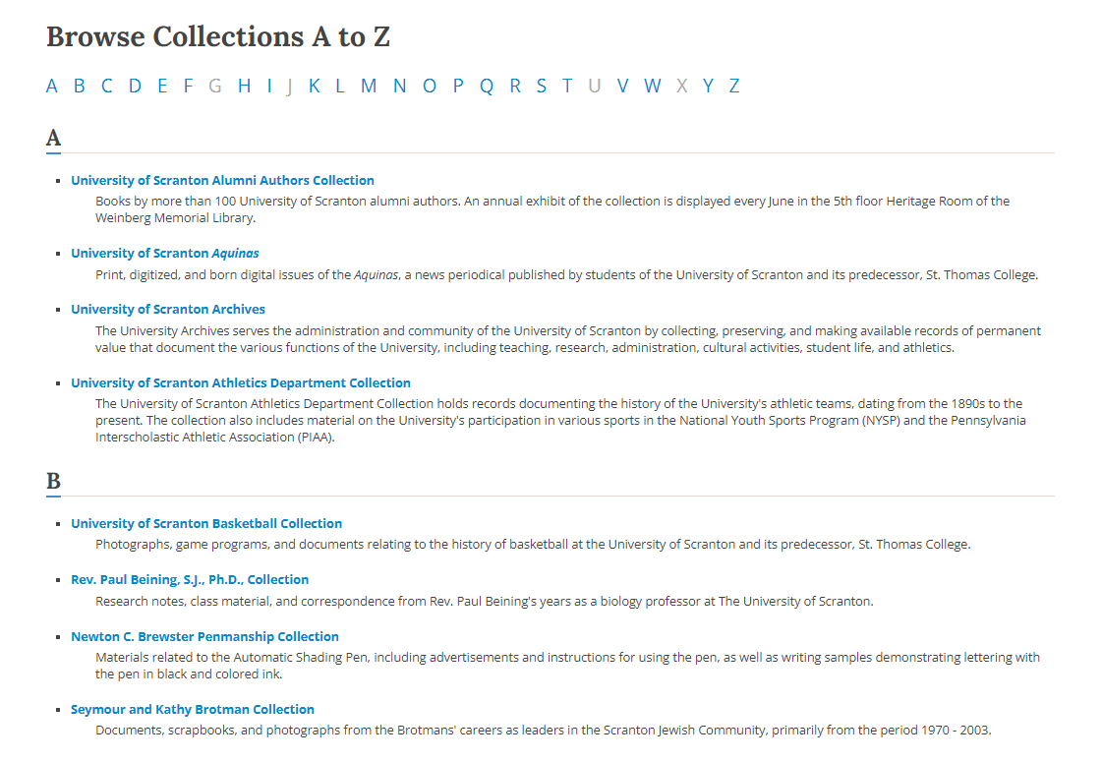
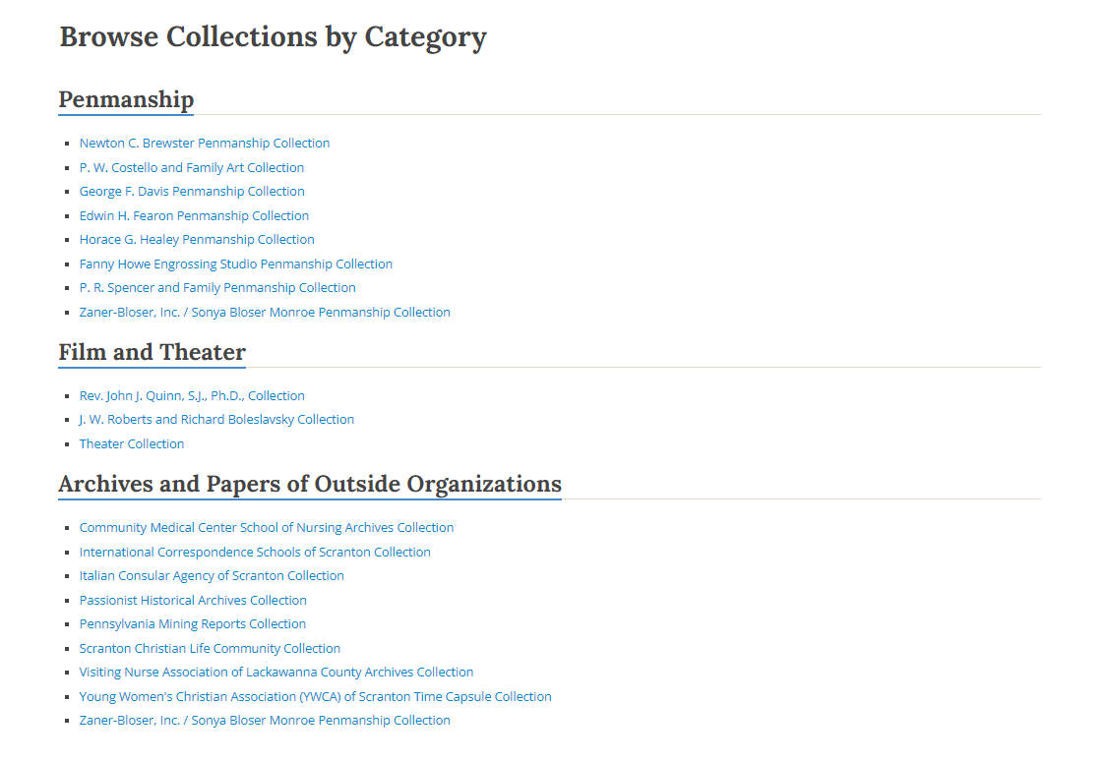
Browse Lists

Slide 19
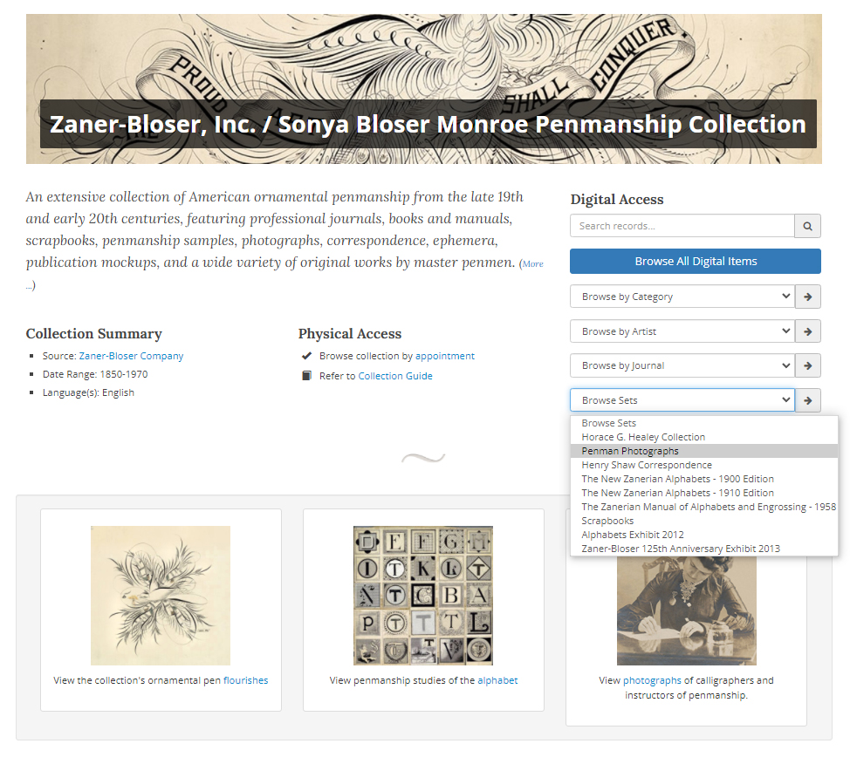
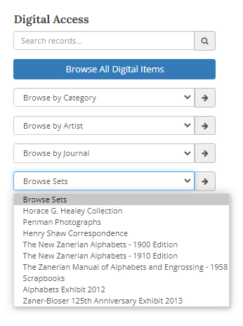
Collection Landing Page: Facet Dropdowns

Slide 20
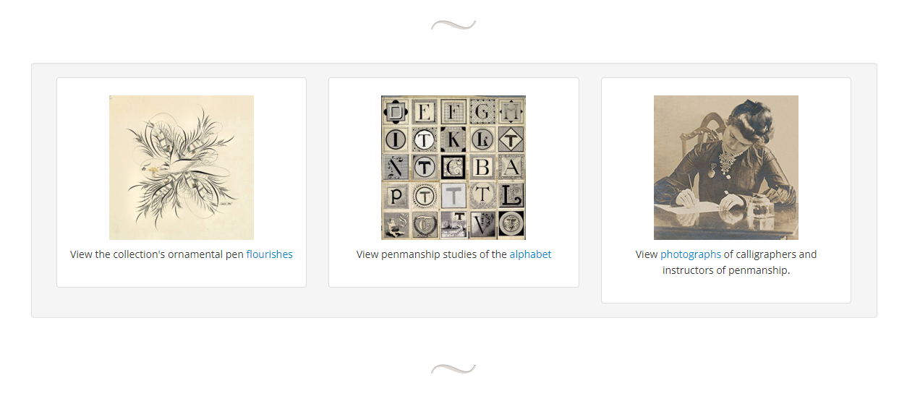
Collection Landing Page: Featured Boxes

Slide 21
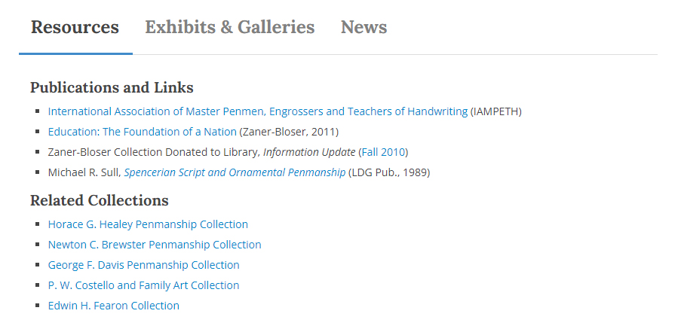
Collection Landing Page: Related Content

Slide 22
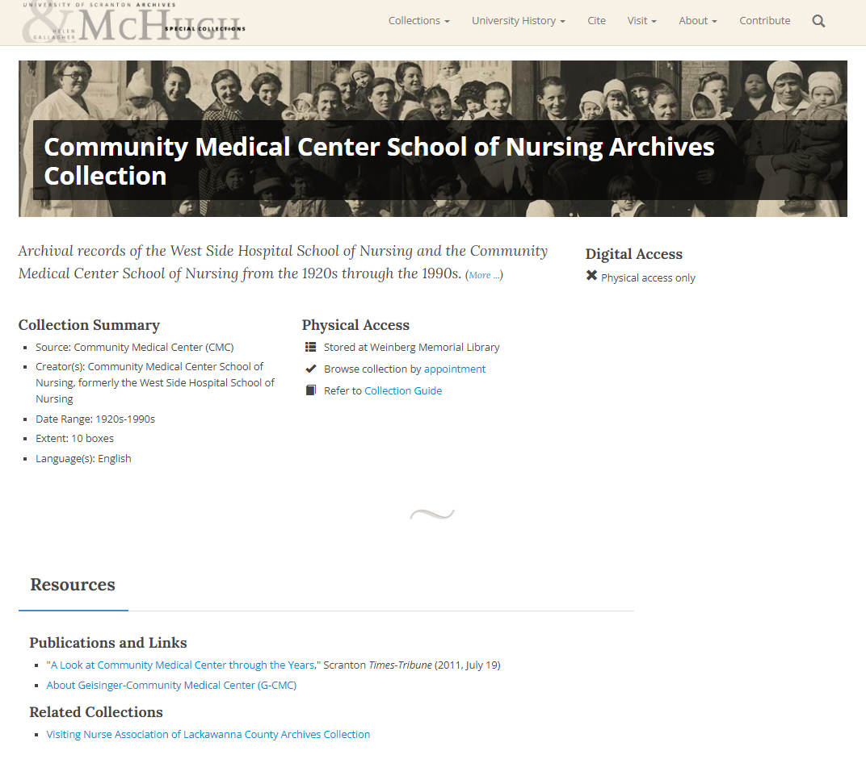
Collection Landing Page: No Digital Items
Digital item search features can be added easily when/if we digitize items from the collection.

Slide 23
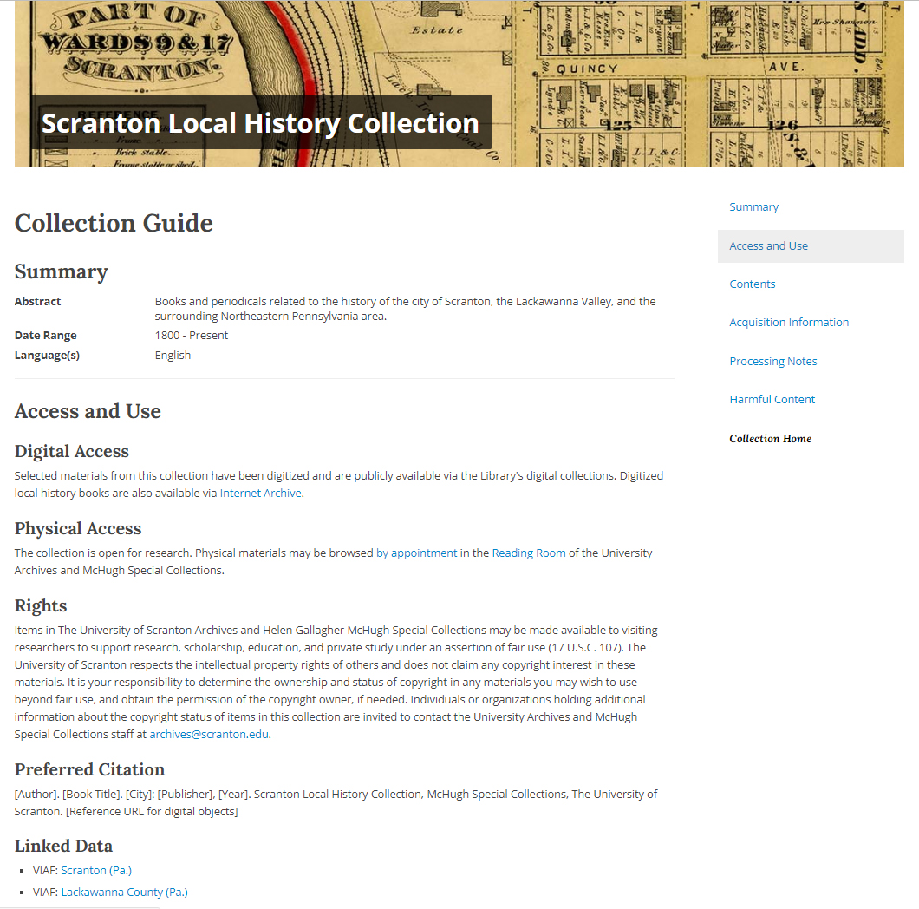
Collection Guide
One guide for each collection
Contains access information, scope and content note, box inventory, acquisitions information, and digitization information (if any)

Slide 24
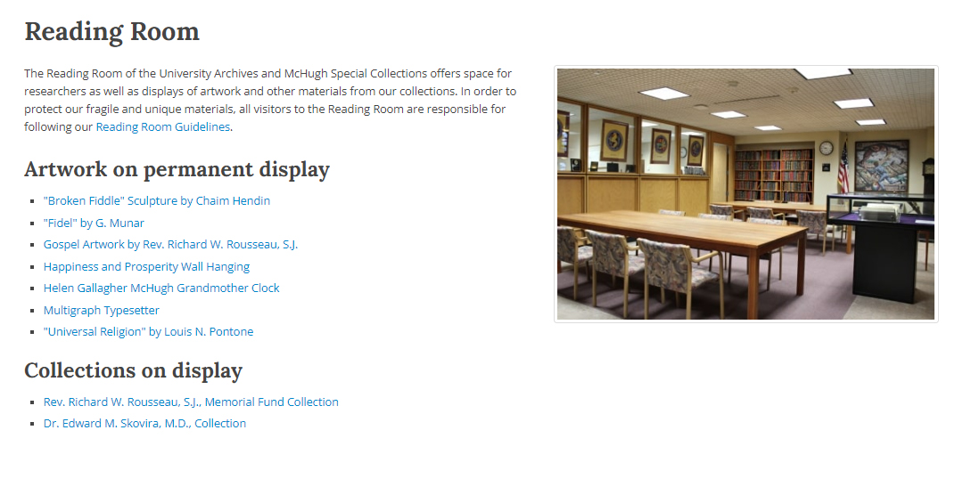
Supporting Content

Slide 25
Timeline

Slide 26
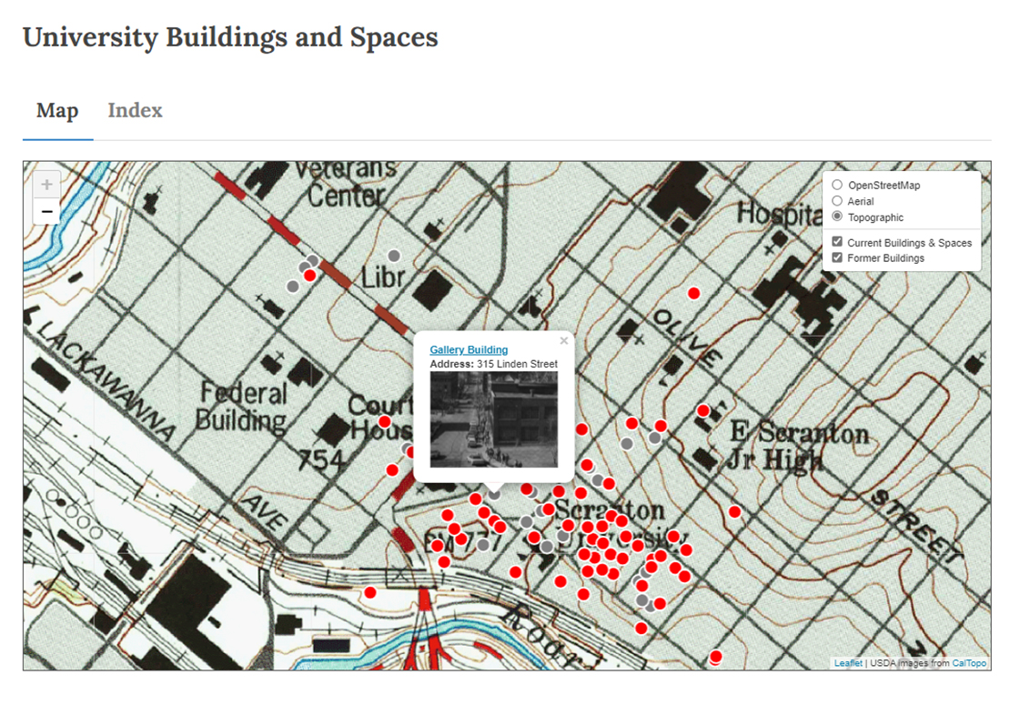
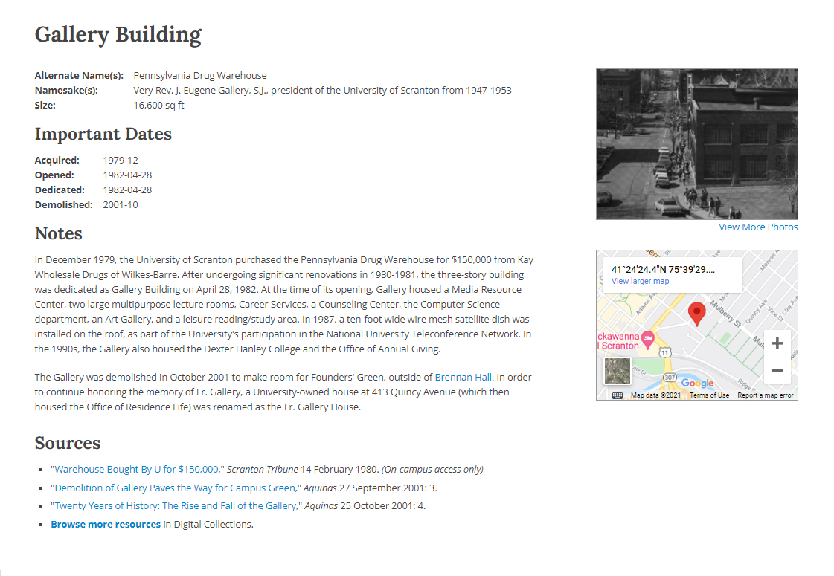
Campus Building Map

Slide 27
Next Steps

Slide 28
Next Steps
How might we improve access to our collections, promote them, and keep them useful and relevant to our patrons?
Better integration with physical exhibits in the library and digital exhibits in Omeka
Ensure that any new ILS/LSP under consideration integrates with our collection content
Increase use of timeline views and maps to visualize content in context
Continue promoting the use of our collections in the classroom and through the Humanities Center
Graphic design refresh?

Slide 29
Explore Our Collections!
The University of Scranton Archives and Helen Gallagher McHugh Special Collections are available online here:
https://digitalservices.scranton.edu/
Please visit and let us know what you think!

Slide 30
Thank you!
Background information
Jennifer Galas and Kristen Yarmey, A New Look for Special and Digital Collections, The Harry & Jeanette Weinberg Memorial Library Information Update, Fall 2016, p. 2. https://digitalservices.scranton.edu/digital/collection/publications/id/563/rec/7
Jennifer Galas. Building Order: Using Free Tools & Templates to Streamline Content Management Workflow, a presentation given at CONTENTdm Users Group Conference, May 28, 2015, Baltimore, MD. https://jennifergalas.com/code/building-order/
If you have additional questions or would like
more information, please contact:
Jennifer Galas
jennifer.galas@scranton.edu

