Slide 1
Welcome to the DNA
Dynamic National Archive
of Women in American Architecture

Slide 2
The DNA is
… a publicly accessible, digital, open-source archive documenting the work of women architects and designers who have contributed to the places and spaces of the United States.
… and you can help build it!

Slide 3
The DNA began in 2007 as a wiki-style website. Over the years, more than 1,300 architects’ biographies were contributed.

Slide 4
In 2019, the DNA website was rebuilt on a modern, standards-compliant WordPress platform for greater ease of use and maintainability.

Slide 5
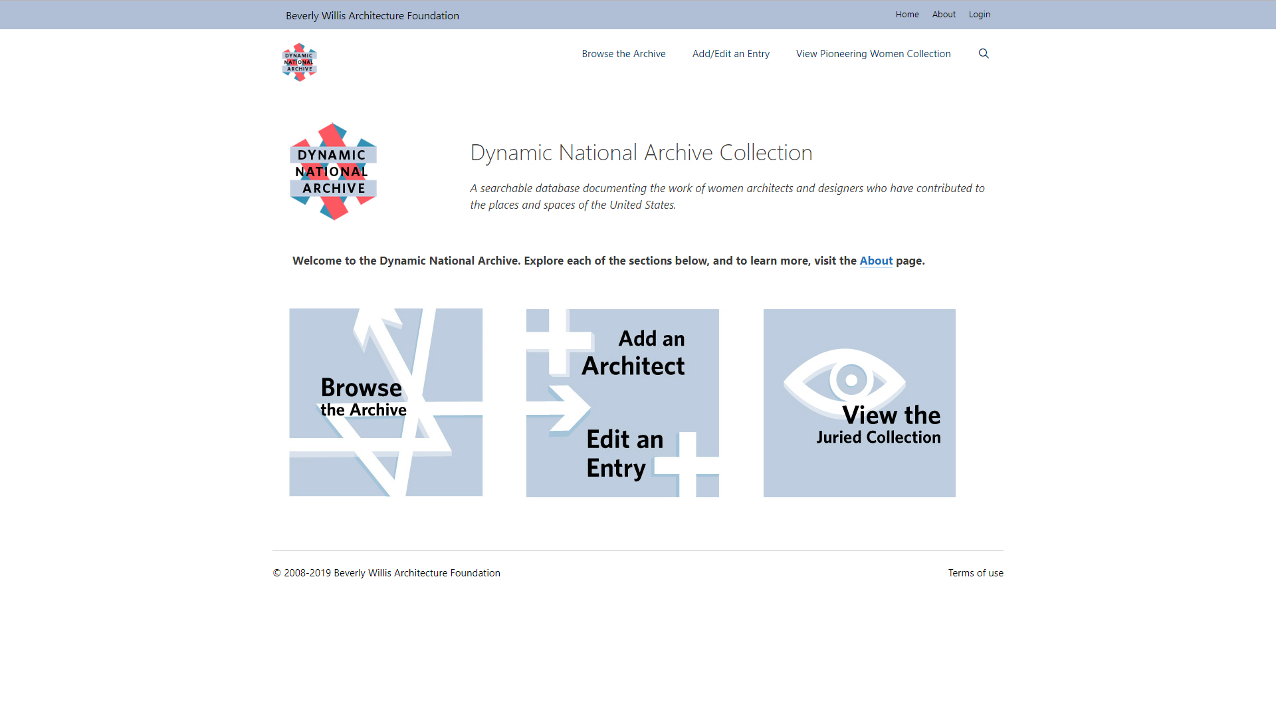
Navigation
https://dna.bwaf.org

Slide 6
Navigation

Slide 7
They offer easy access to the basic functions and sections of the website.
Two navigation bars appear at the top of each page.

Slide 8
Navigation
https://dna.bwaf.org

Slide 9
Navigation

Slide 10
Note that there is a keyword search function that you can also access from any page.

Slide 11
Navigation

Slide 13
Browsing

Slide 14
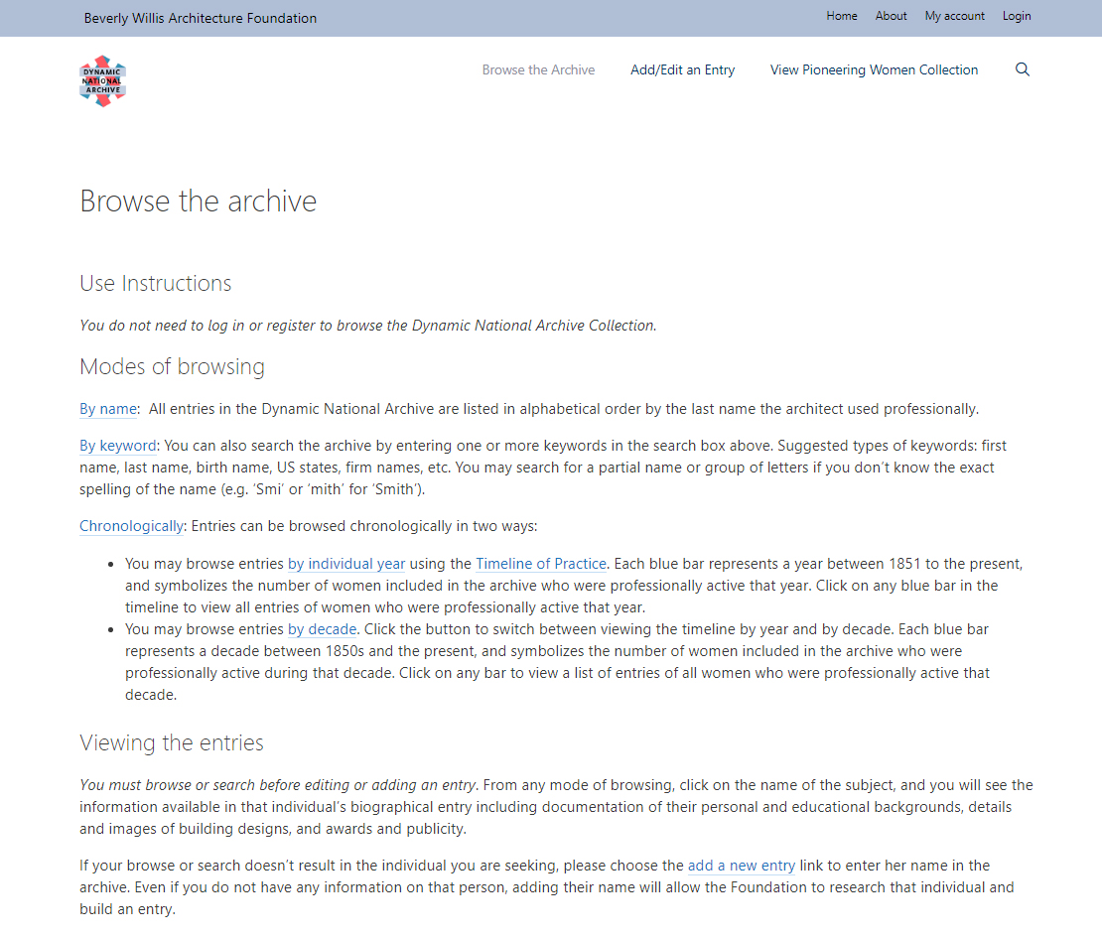
https://dna.bwaf.org/browse-the-archive

Slide 15
Entries in the DNA
may be browsed:
By name

Slide 16
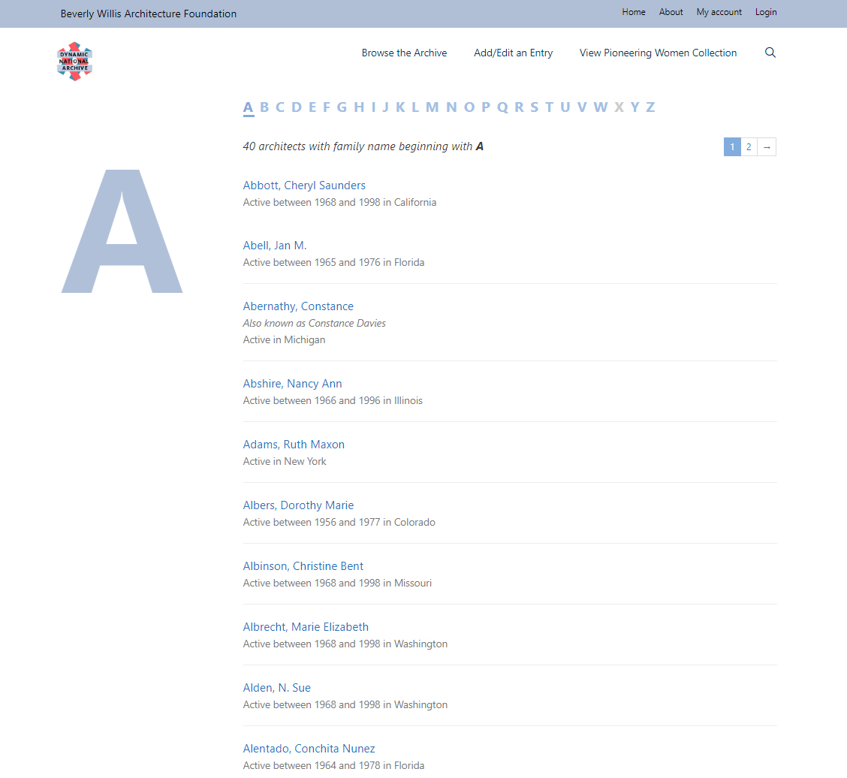
https://dna.bwaf.org/architects/a

Slide 17
Entries in the DNA
may be browsed:
By name
By keyword

Slide 18
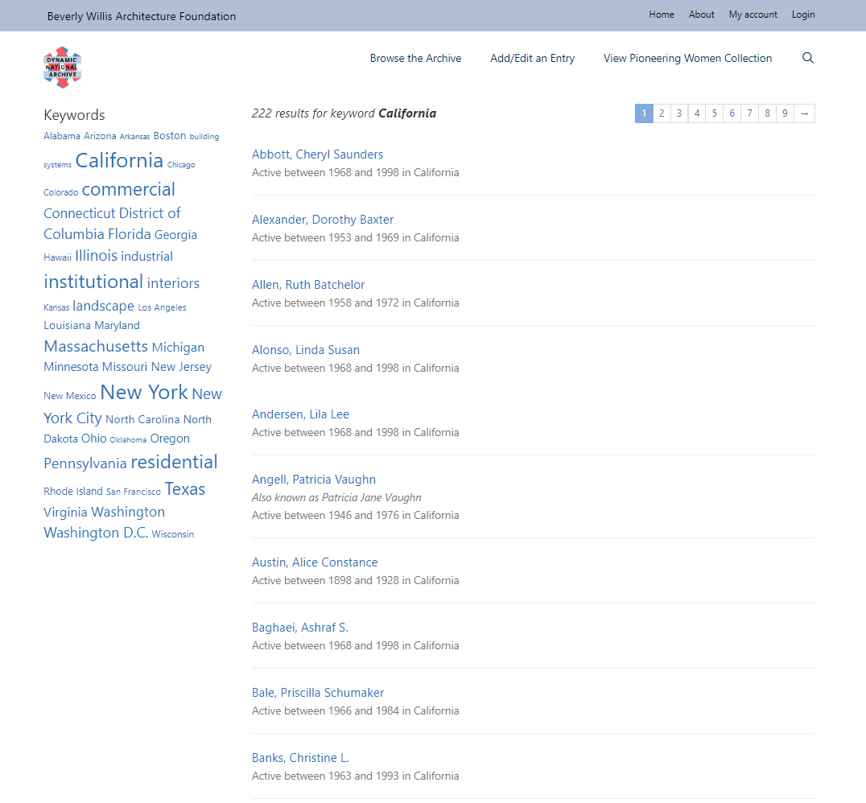
https://dna.bwaf.org/keyword/california

Slide 19
Entries in the DNA
may be browsed:
By name
By keyword
Chronologically

Slide 20
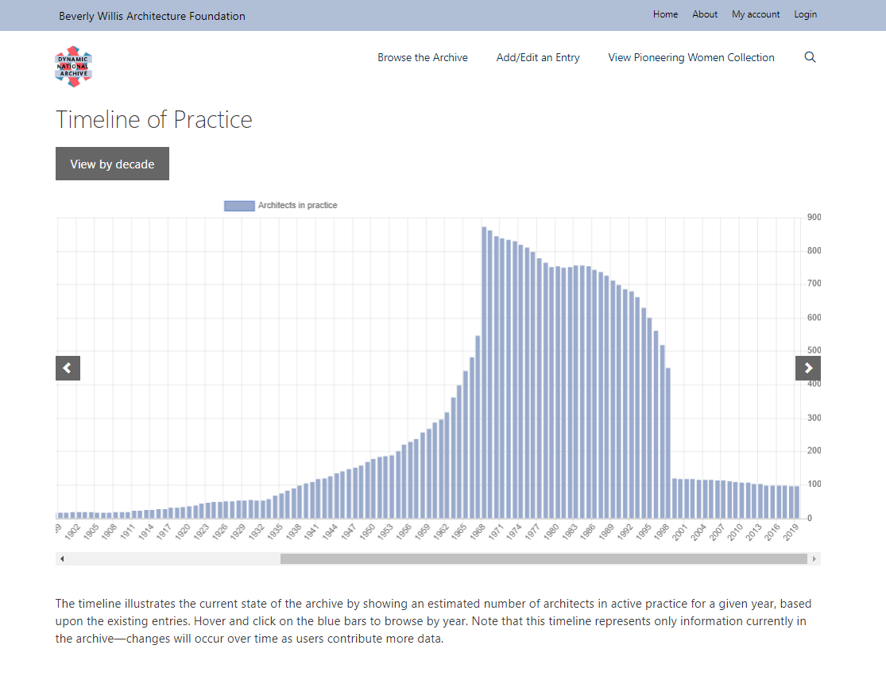
https://dna.bwaf.org/timeline

Slide 21
Each entry displays the information
currently stored in the DNA about
a particular architect.

Slide 22
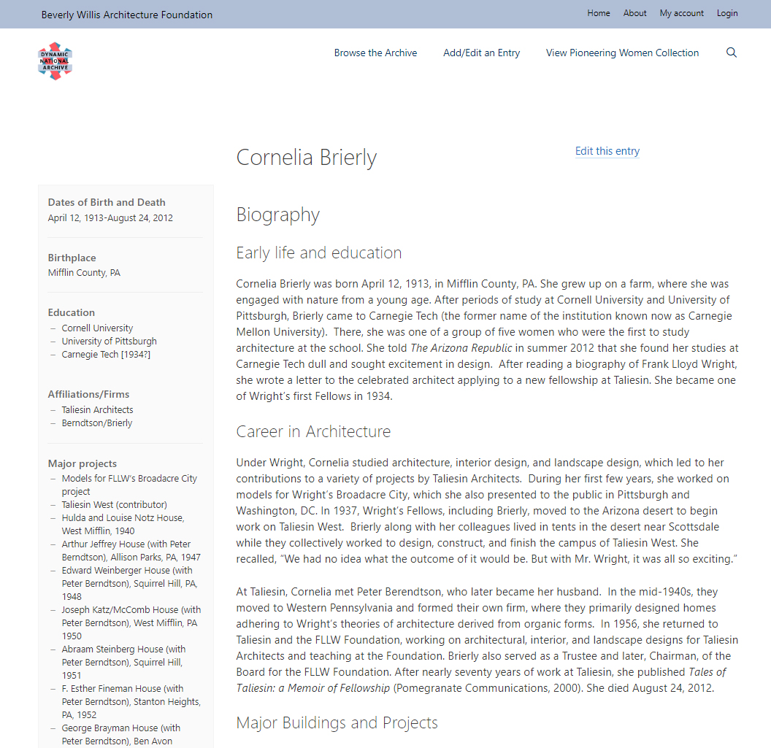
https://dna.bwaf.org/architect/brierly-cornelia

Slide 23
If you would like to add or
edit an entry, you’ll need
to register an account.

Slide 24
Registering an Account

Slide 25
You will see a link to register on the Login page.

Slide 26
Navigation

Slide 27
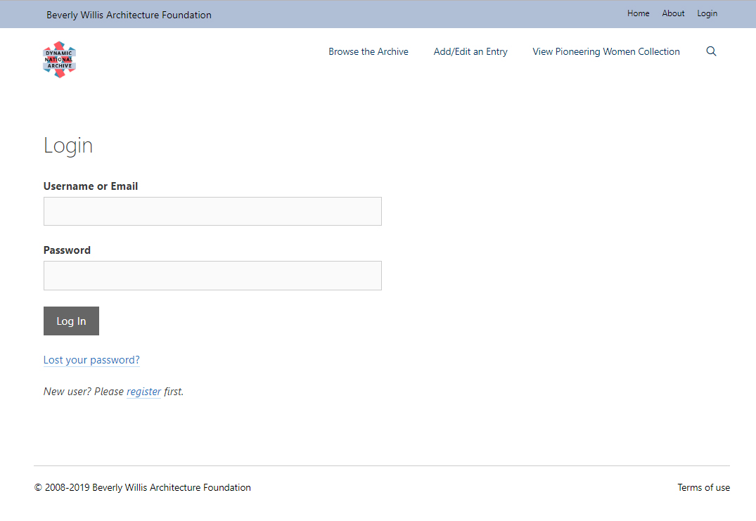
Navigation
https://dna.bwaf.org/user-login

Slide 28
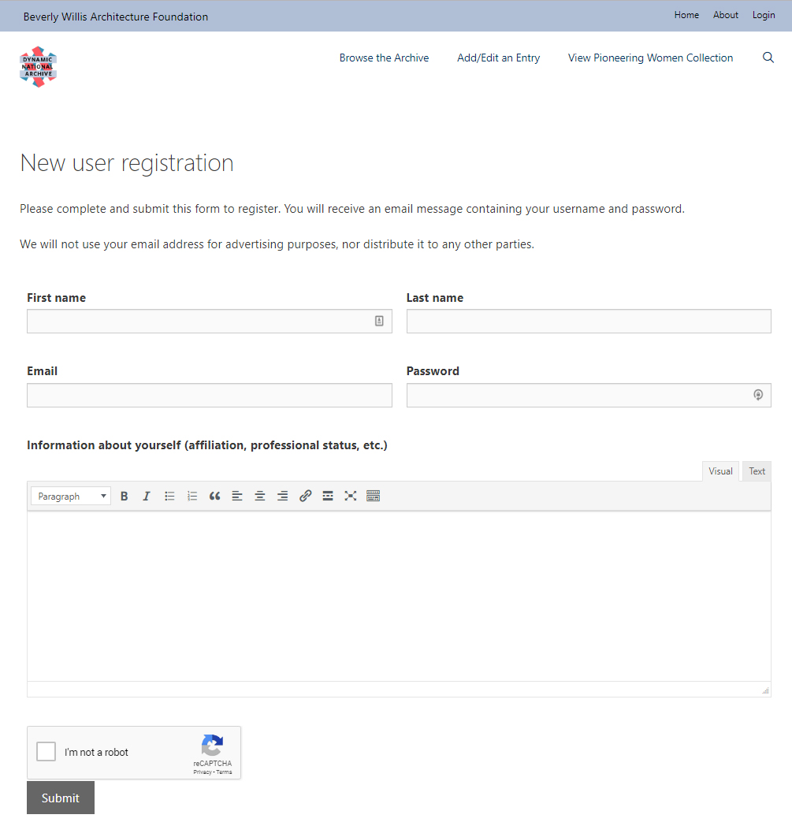
https://dna.bwaf.org/new-user-registration

Slide 29
Logging In

Slide 30
You may log in at any time by
clicking the Login link in the
navigation menu.

Slide 31
Navigation

Slide 32
If you see an entry you’d like to edit, you may also log in from any architect’s biography entry.

Slide 33
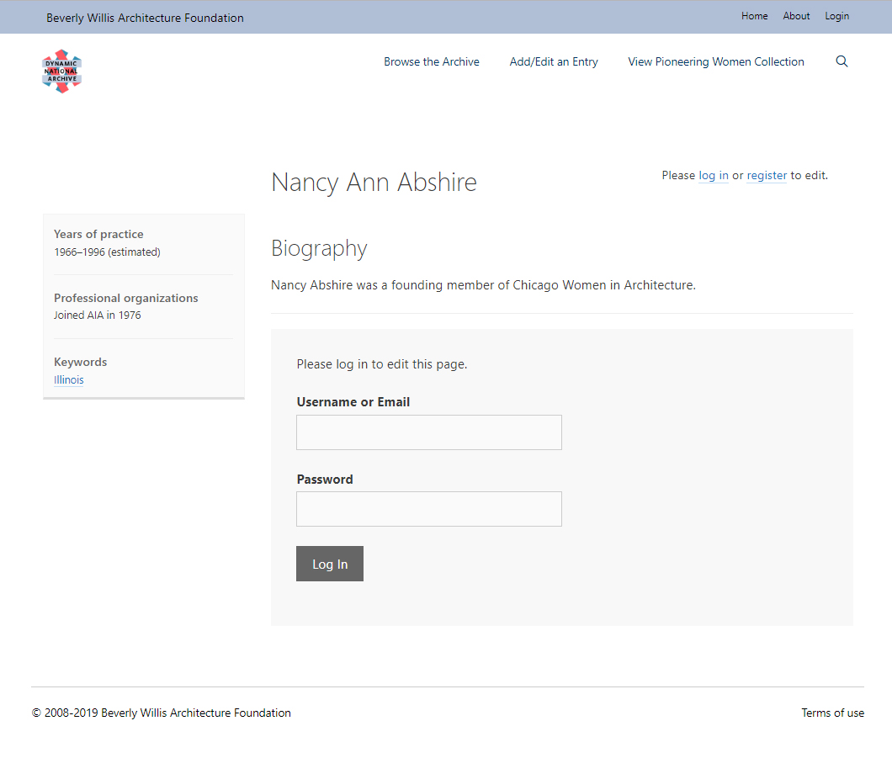
https://dna.bwaf.org/architect/abshire-nancy-ann

Slide 34
Adding an Entry

Slide 35
Then, choose the Add/Edit an Entry link.
First, browse or search to make sure the architect you’d like to add isn’t already listed in the DNA.

Slide 36
Navigation

Slide 37
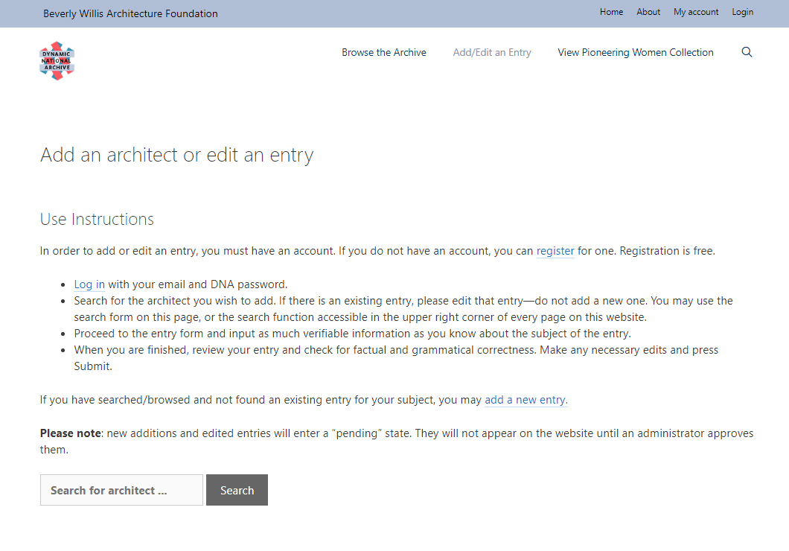
Navigation
https://dna.bwaf.org/entry-instructions

Slide 38
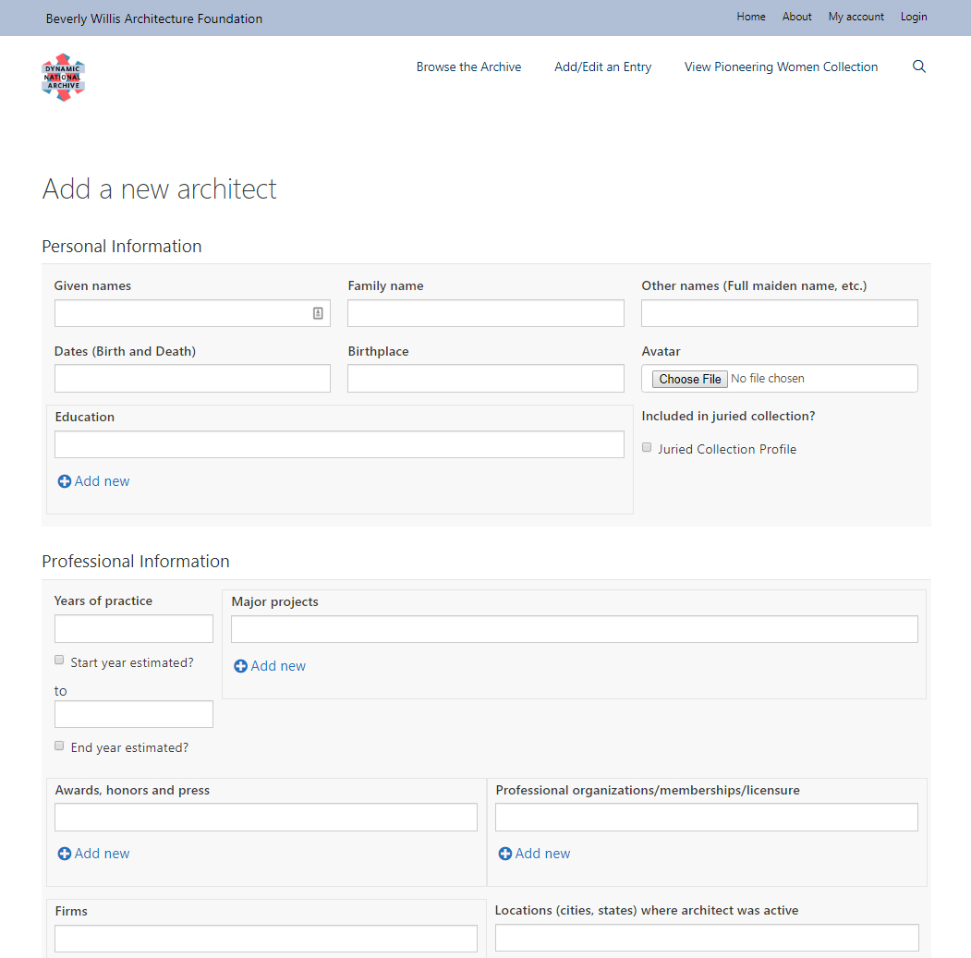
Navigation
https://dna.bwaf.org/add-new-architect

Slide 39
Fill out as much information
as you can, and submit the form.
When your submission is approved by an administrator, it will appear on the website.

Slide 40
Editing an Entry

Slide 41
From the existing architect biography, click the Edit this entry link.

Slide 42
https://dna.bwaf.org/architect/brierly-cornelia

Slide 43
The form will be populated with the information currently in the database.

Slide 44
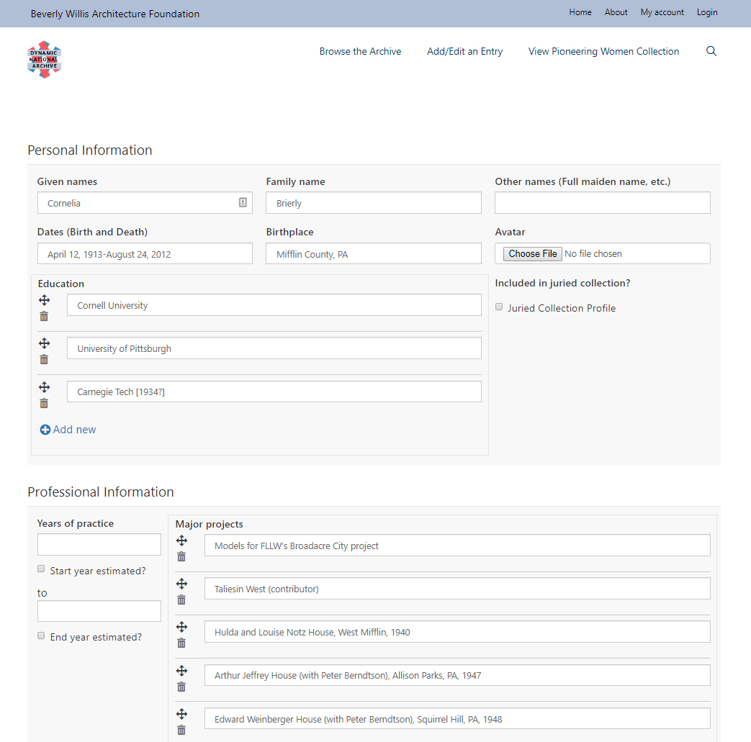

Slide 45
Add your information or edit existing information, and submit the form.
When your submission is approved by an administrator, it will appear on the website.

Slide 46
Entry instructions are also summarized on the Add/Edit an Entry page.

Slide 47
Navigation

Slide 48
Navigation
https://dna.bwaf.org/entry-instructions

Slide 49
Thank you!
Please help us build the DNA!

Slide 50
Any questions?
Please contact Jennifer Galas:
jennifer.galas@scranton.edu

