Slide 1
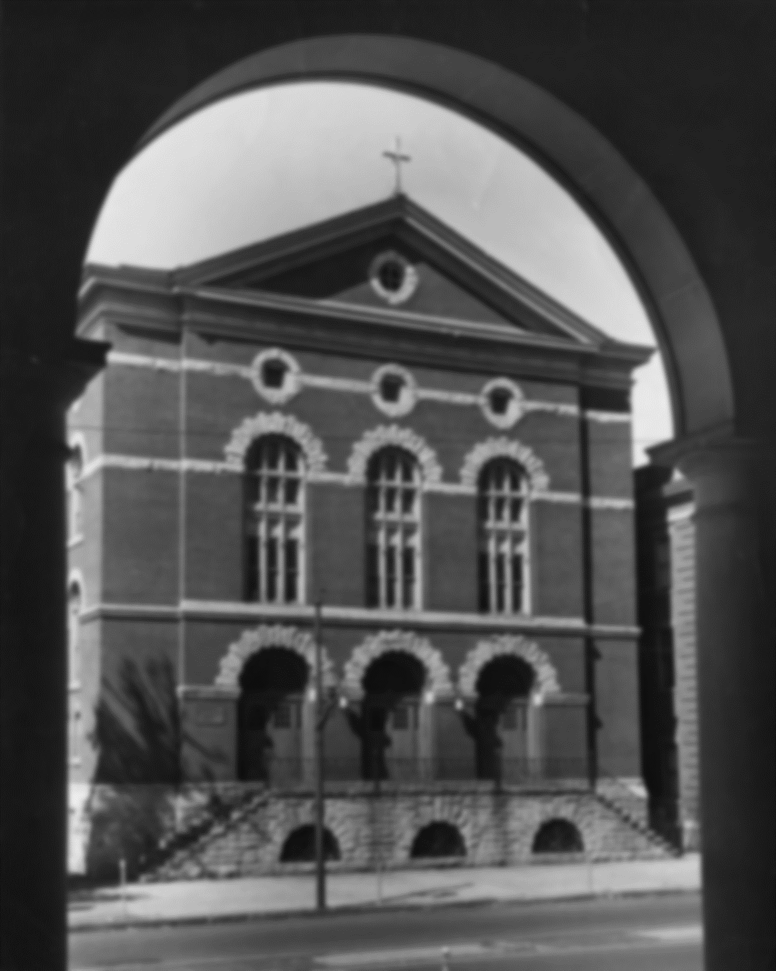
Building Order Using free tools & templates to streamline content management workflow
Jennifer K. Galas, MSLIS
Library Systems Specialist
Digital Services Web Developer
The University of Scranton

Slide 2
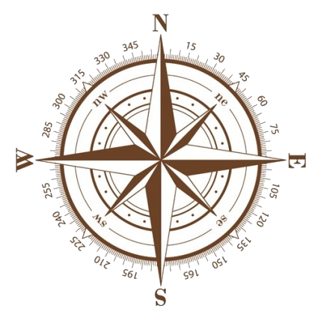
Where are we going?
Project Background
Building and Using the App
The Road Ahead

Slide 3
Project Background

Slide 4
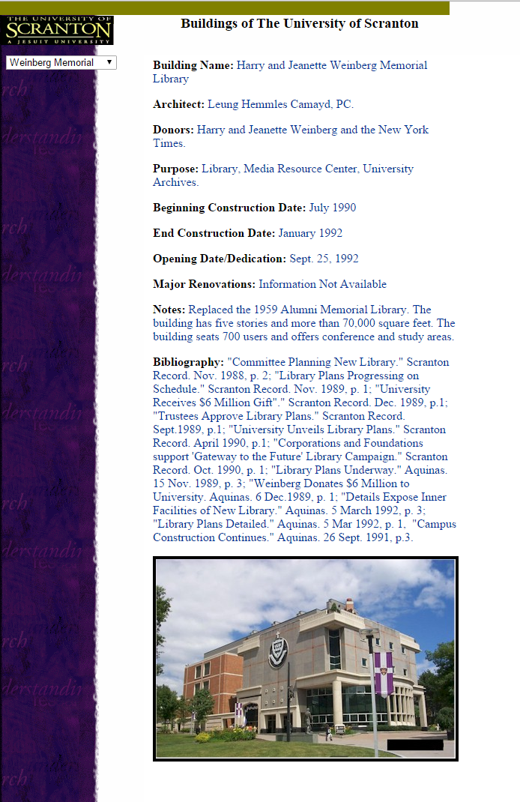
Version 1.0
January 2002
Hand-coded HTML

Slide 5
Version 1.0
January 2002
Student assignment
Great idea! Good work!
But no workflow for
maintenance.

Slide 6
Version 1.0 creation
Research
Static web page
HTML code
Student

Slide 7
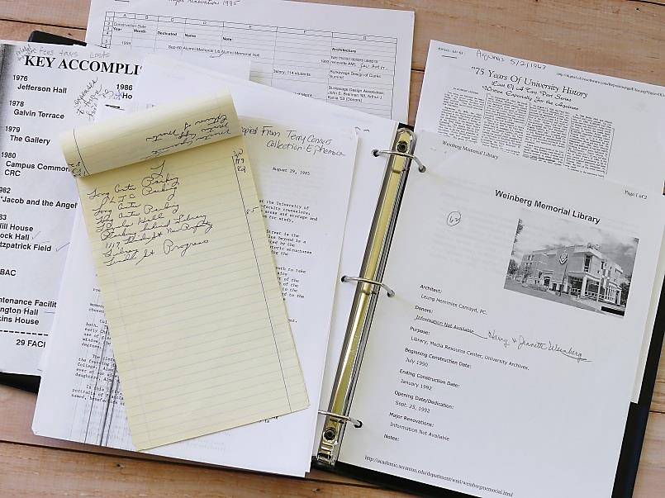
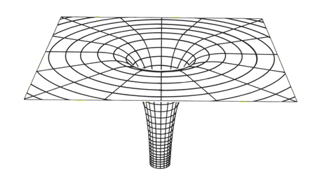
Version 1.0 update workflow
Library Staff
Updates on paper
Black Hole?

Slide 8
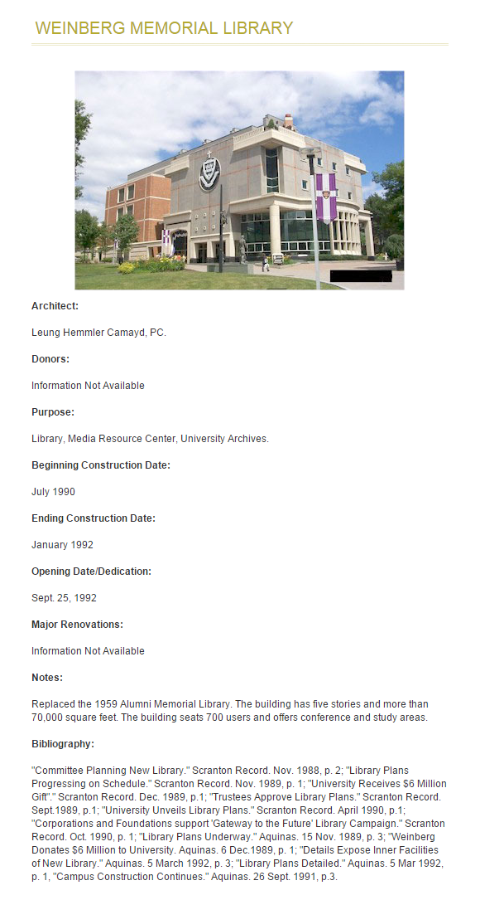
Version 2.0
June 2010
University CMS

Slide 9
Version 2.0
June 2010
Transfer content by hand
No obvious improvement
Data loss!!!

Slide 10
Version 2.0 creation
Static web page
zzz
Student
University CMS

Slide 11
Version 2.0 update workflow
zzz
Mythical staff
Library Systems
University CMS

Slide 12
Version 2.0 update workflow

Slide 13
What’s the problem?
Missed opportunities
Collect and display historical information about our campus
Benefit from diverse knowledge and energy of our staff
Inspire everyone to become a content creator
Try something new in a low-stakes environment

Slide 14
Let’s try something new!

Slide 15
Inspiration
Scrapbook project
50,000+ newspaper clippings & ephemera dating back to 1930s
Digital Services proposed cross-departmental workflow
Lots of University history content!

Slide 16
Wouldn’t it be great?
Dynamically update pages when new information is discovered
Consistent, easily modified template-based design
Easily pull and highlight content from our digital and print collections
Anyone can update content!

Slide 17
Building the app

Slide 18
Why CONTENTdm?
Not required for this project! However …
More freedom than the alternatives on campus
Easy integration with our digital content
Test case in working toward a larger University history project in CONTENTdm

Slide 19
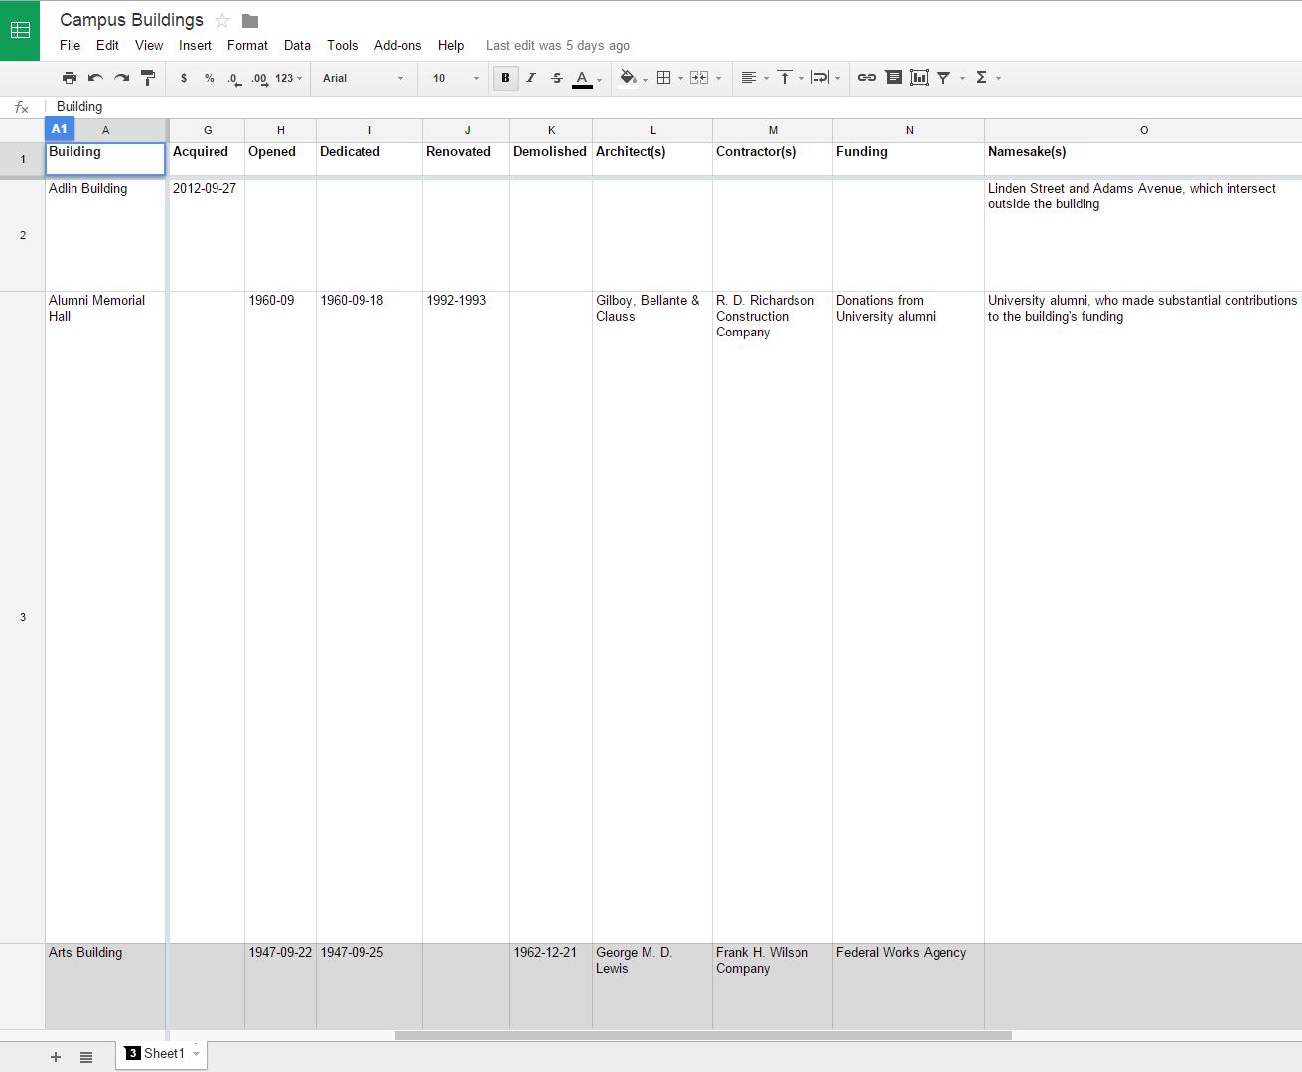
Let’s take this …

Slide 20
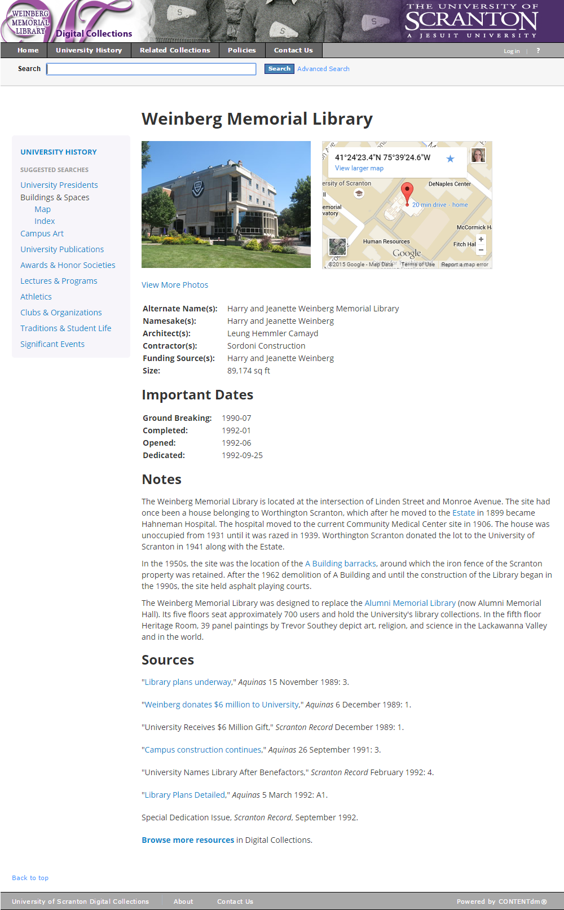
And make this.

Slide 21
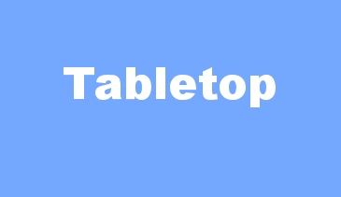
The raw materials
Google Spreadsheet – published to the web
Two script libraries: Tabletop.js and Handlebars.js
Notice: actual coding not (really) required

Slide 22
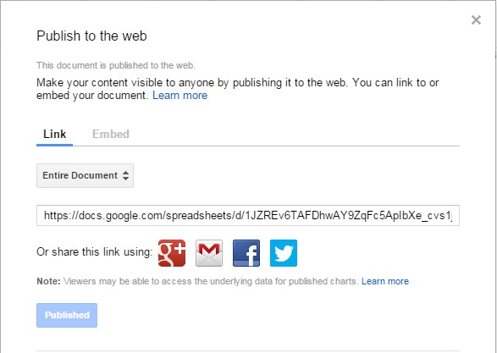
Spreadsheet setup
Analyze the data you want to track and display
But you can always add, remove or change later!
Each row is an instance of the objects you’re tracking; each column is an attribute
Publish to web & share with participants!

Slide 23
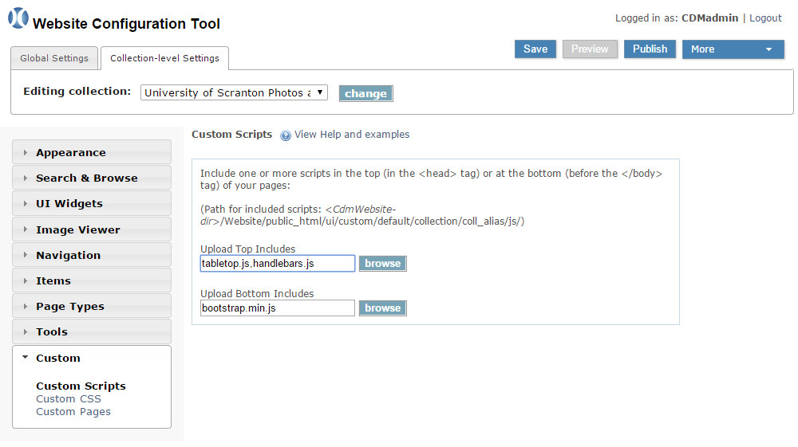
Linking up the scripts

Slide 24
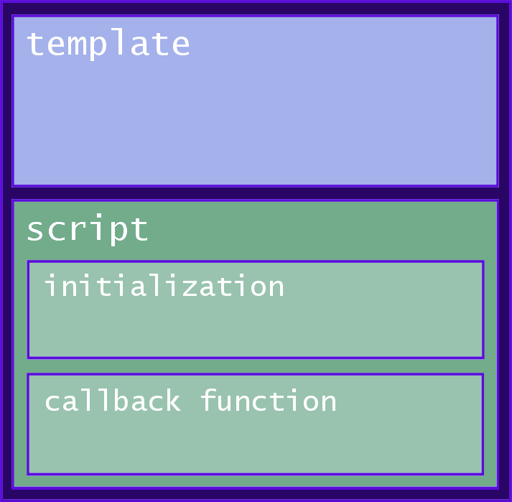
Coding the template page

Slide 25
Initialization

Slide 26
Coding the template page

Slide 27
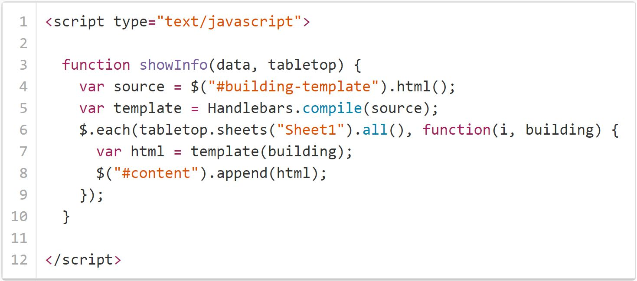
Callback function (basic)

Slide 28
Resulting view
Row 1 info
Row 2 info
Row 3 info
. . .
Row 4 info
Row 5 info

Slide 29
Callback function (modified)

Slide 30
Resulting view
. . .
Row 1 info
Row 2 info
Row 3 info
Page 1
Page 2
Page 3

Slide 31
Coding the template page

Slide 32
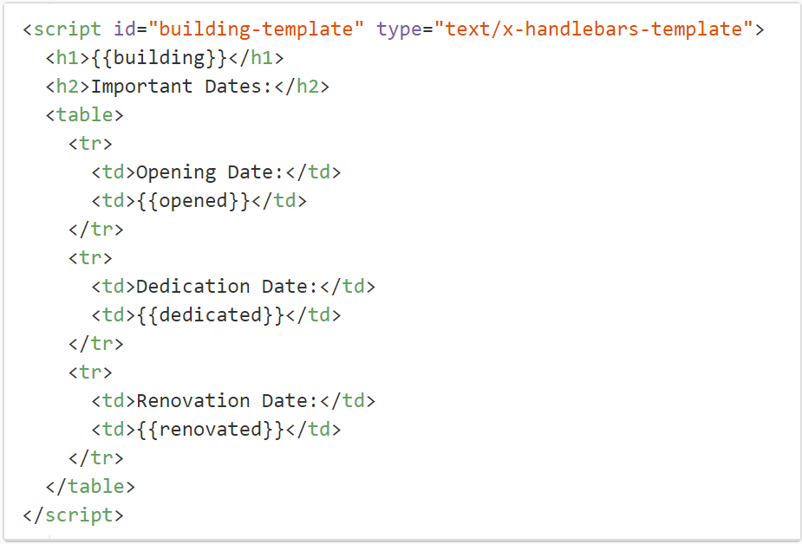
Template

Slide 33
New workflow … almost.
Project participants
Google spreadsheet
New building page!

Slide 34
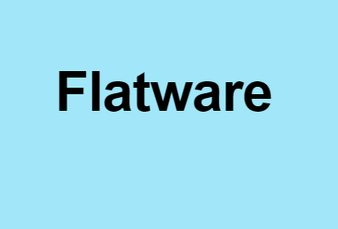
Flatware
Simple proxy: pull data from S3 bucket instead of directly from spreadsheet
Add 1 line to your init function
Sync with one click

Slide 35
New workflow … complete!
Participants
Spreadsheet
Flatware/S3 cache
New building
page!

Slide 36
Using the app

Slide 37
What can go wrong?

Slide 38
A few things
Local errors
Third-party services (Google) can make changes with little warning
Abandonment of “hobby” projects

Slide 39
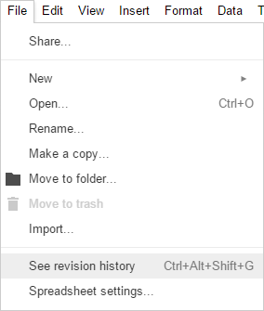
What you can do
Always have a backup and escape plan!
/cache/

Slide 40
What you can do
Read API notices & changelogs
Follow (“watch”) projects on
GitHub

Slide 41
What you can do

Slide 42
What you can do
Always be on the lookout for new tools and techniques
Will a different workflow work better?

Slide 43
The road ahead

Slide 44
Mapsheet.js
Another great script from
Jonathan Soma
Add a few columns to your
spreadsheet …
… and generate a map!
latitude
longitude

Slide 45
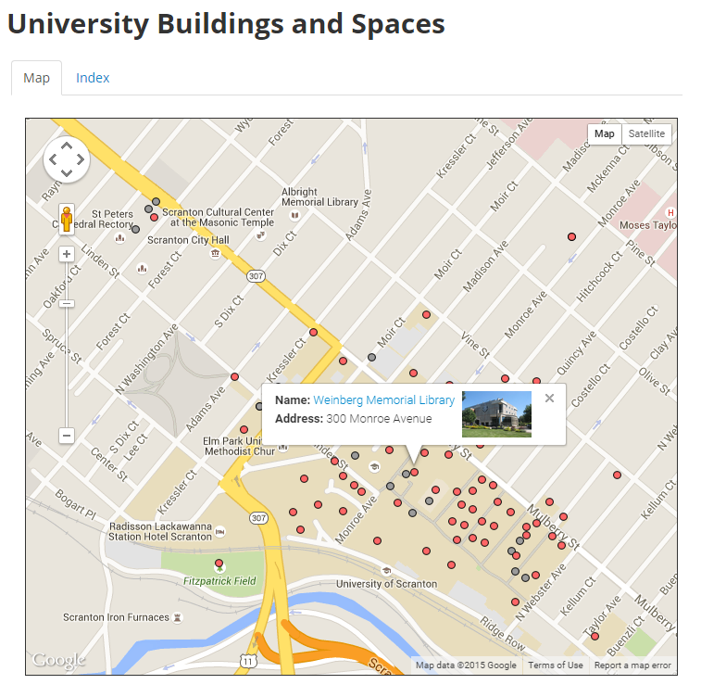
Mapsheet.js

Slide 46
Other ideas?
Google Forms for input
Library consortia projects
Inventory projects
Project tracking
On-site/mobile data collection

Slide 47
Before
zzz

Slide 48
Now
Hundreds of updates by students & staff from different departments
88 gorgeous buildings & spaces pages
Links to digital content using API and queries
Easily exportable data
Lots of ideas for the future!

Slide 49
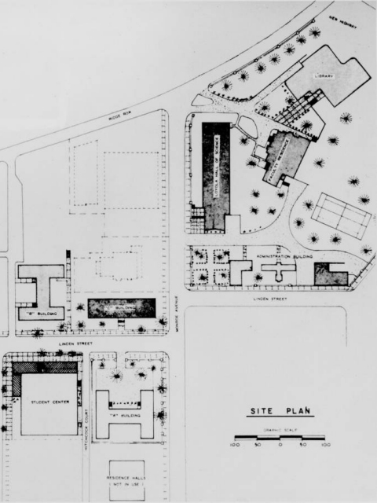
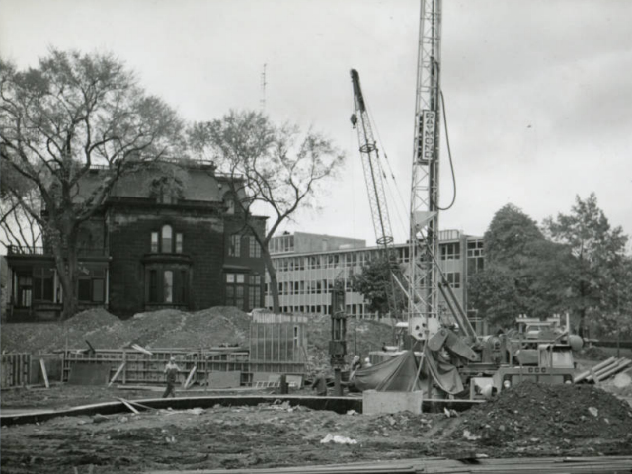
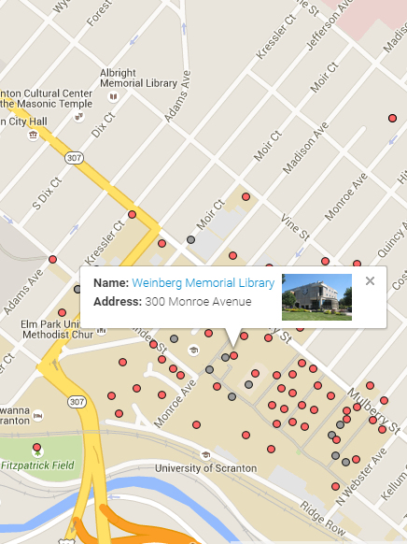
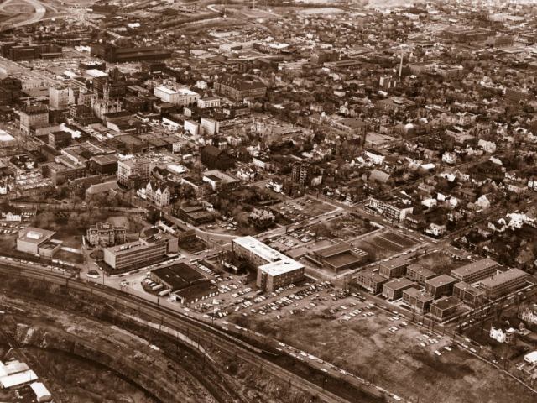
bit.ly/uofs-buildings

Slide 50
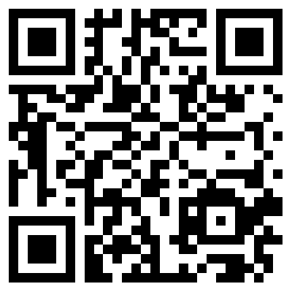
Thank you!
jennifer.galas@scranton.edu
jennifergalas.com

